Slide 1
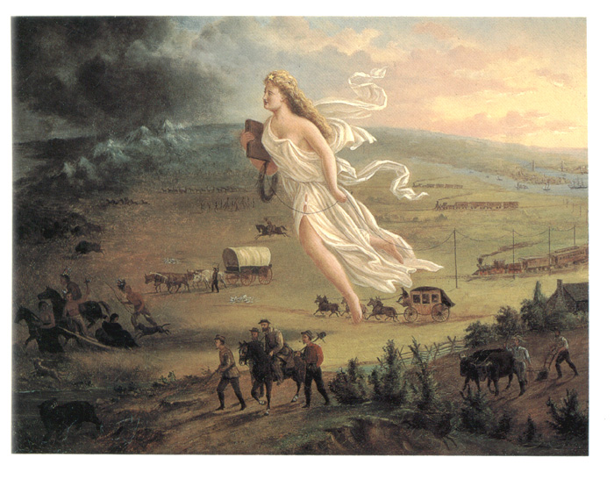
Westward Expansion 1801-1861

Slide 2
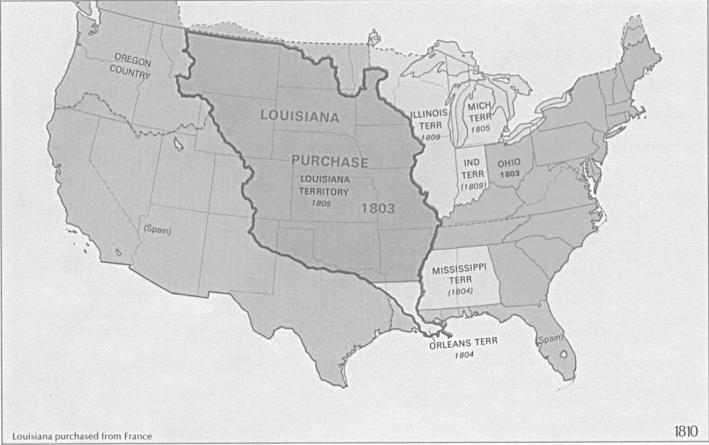
Post-Revolutionary America

Slide 3
The Louisiana Purchase
Louisiana Purchase - 1803
Jefferson bought land from France, which doubled the size of the United States.
Lewis and Clark expedition, explored the Louisiana Purchase from the Mississippi River to the Pacific Ocean.

Slide 4
Lousiana Purchase

Slide 5
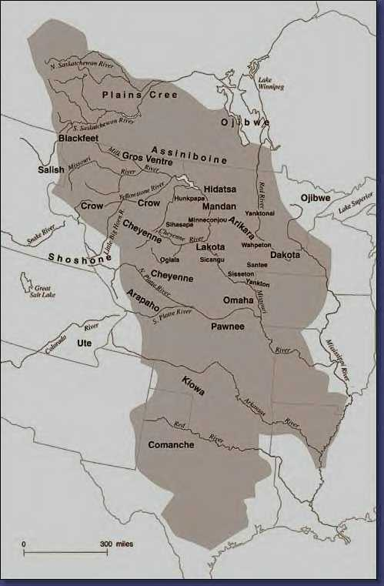
Native American Land
Native Americans lived here first.
Native and Whites came into bloody conflicts over the land.
The United States government forced Natives onto reservations.

Slide 6
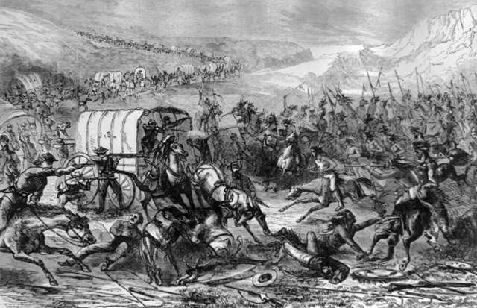
Indians defend their lands, but are defeated in the end.

Slide 7
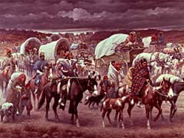
Native Americans are forced onto reservations.

Slide 8
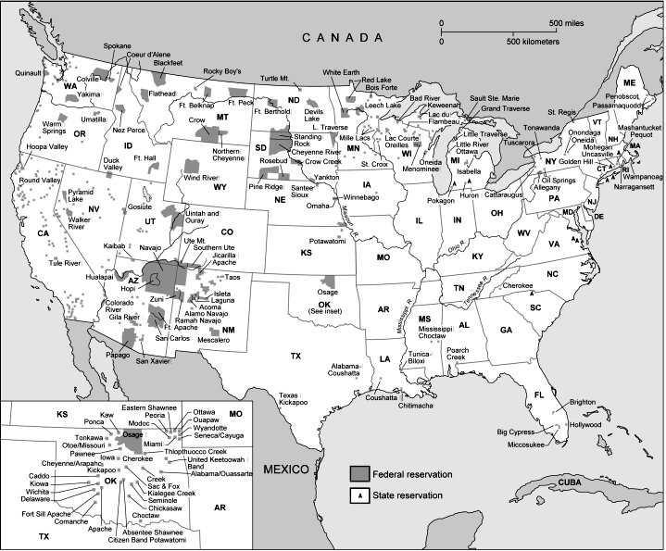
Laws today protect Native American Reservations.

Slide 9
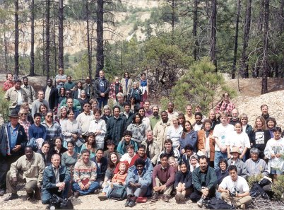
Native Americans today.

Slide 10
Other Territories
Florida - 1819
Spain gave Florida to the United States through a treaty.
Texas – 1836 (Republic) 1845 (State)
Texas was added after it became an independent republic.
Oregon - 1849
The Oregon Territory was divided by the United States and Great Britain.
California – 1850
War with Mexico resulted in California and the southwest territory becoming part of the United States.

Slide 11
Florida, Texas, Oregon, California

Slide 12
Gold Rush-1849 - 1870
Gold was discovered in California in 1849.
People who moved west to mine are called miners.
Immigrants, such as Mexicans, Chinese and the Irish, went to work in the mines.
Immigrants were treated poorly with long hours, low pay and very dangerous work.

Slide 13
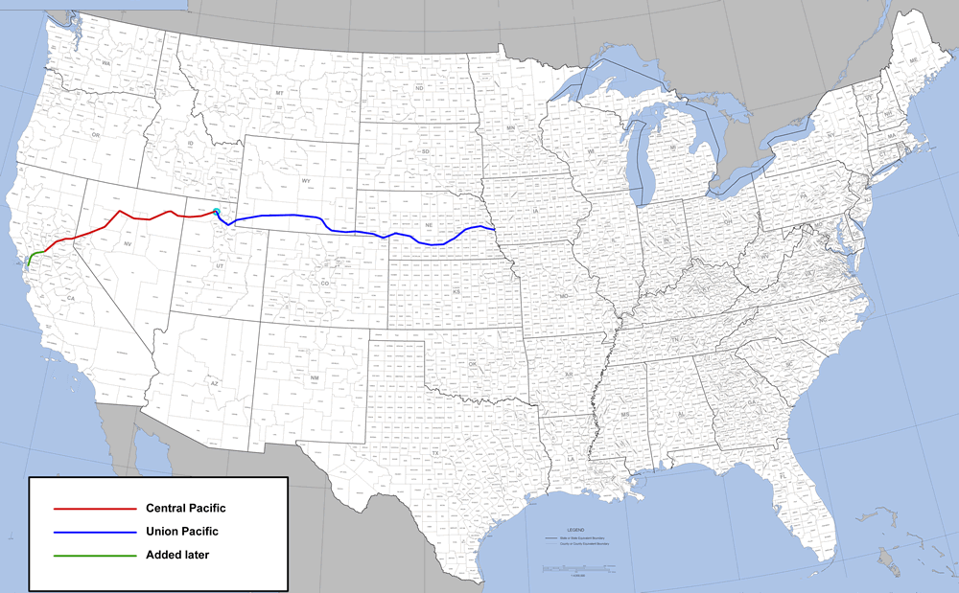
The Transcontinental Railroad finished in 1869.

Slide 14
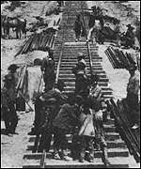
Many Immigrants, such as Irish, Mexicans and Chinese were building the Railroad.

Slide 15
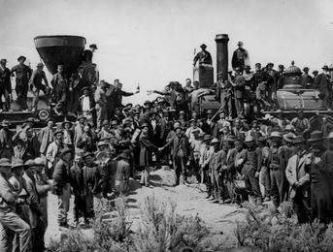
The Union Pacific meets the Central Pacific in Utah in 1869.

Slide 16
JOHN GAST - "AMERICAN PROGRESS" (1872)

