Slide 1
Reconstruction
Three Plans

Slide 2
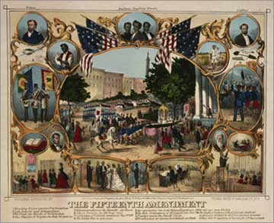
Reconstruction
Reconstruction refers to the decade after the Civil War
It lasted from 1865 – 1877 ???
There were three different plans for Reconstruct the “Union”

Slide 3
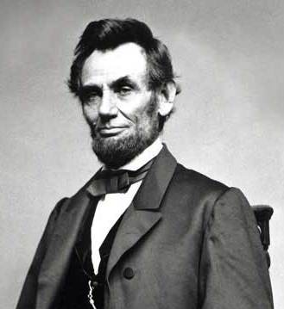
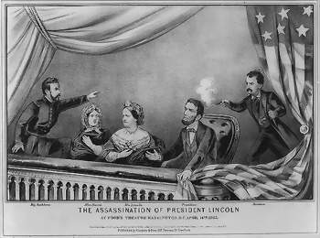
Lincoln’s Plan
Southerners that take oath would be pardon
Southern states could form new governments once 10% of their voters supported it
New state could NOT allow slavery
Most Northerner thought Lincoln’s plan WASN’T harsh enough

Slide 4
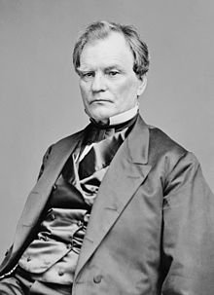
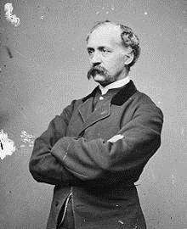
Congress’s Plan
Wade-Davis Bill of 1864, increased voter requirements from 10% to 50%.
No pardons
The Republican party split in two
One side agreed with Lincoln and felt the re-admittance of the states should be done as quickly as possible
The other side wanted the rich planters of the South to be punished and dealt with harshly

Slide 5
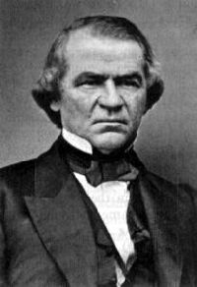
Johnson’s Plan
Offered pardons to southern whites, including the Confederate leaders and rich supporters
Southern states to hold conventions and started new state governments
These new state governments had to abolish slavery and agree to be loyal to the Union
The first to rejoin the Union was Tennessee

Slide 6
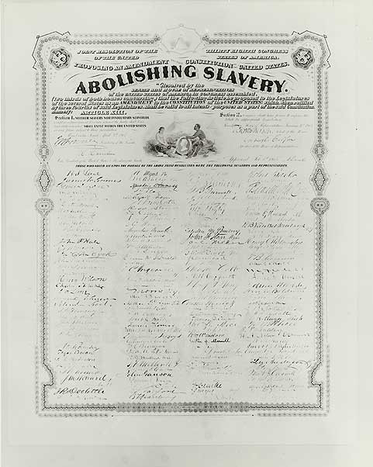
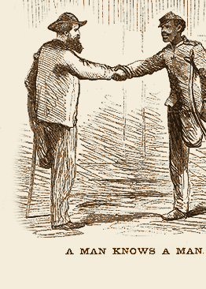
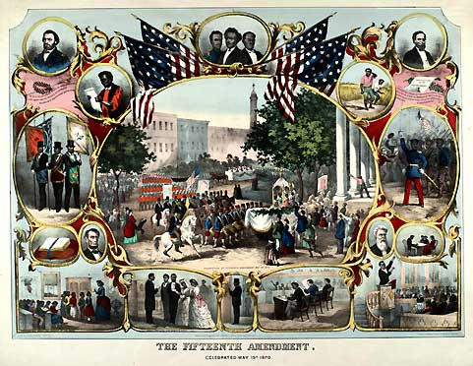
13th Amendment
Outlawed Slavery
14th Amendment
Made former slaves citizens
15th Amendment
Allowed blacks to vote

Slide 7
Powers Won
Reconstruction Acts of 1867 and 1868 passed
Blacks earned the right to vote
Blacks could hold political office.
The first black to be elected to the U.S. Senate in 1870.
Then in 1874. He would be the last black to serve in the Senate until 1966. (92 years later)

Slide 8
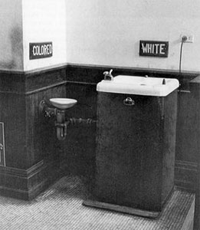
Powers Lost
Black Codes
Laws specifically designed to keep blacks from holding political office.
Codes shared by Confederate States
First, they defined the term "person of color." how much negro blood a person had.
Second, they prevented blacks from voting, holding office, or serving on juries.
Third, they prevented blacks from serving in state militias.
Fourth, they mandated for poor, unemployed persons (usually blacks) be arrested for vagrancy or bound as apprentices.
Fifth, they mandated and regulated labor contracts between whites and free blacks.
Sixth, they prohibited interracial marriages between whites and blacks.

Slide 9
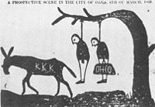
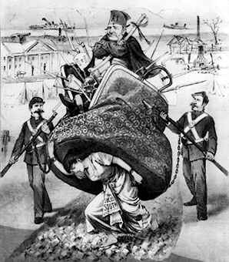
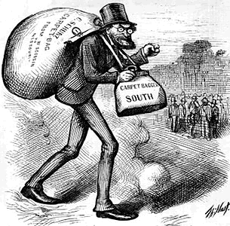
Violence in the South
Scalawags
Southern whites in the Republican party. Southerners that supported Reconstruction.
Carpetbaggers
Northerners who settled in the South
Speculators trying to get rich off of Reconstruction.

