Slide 1
Objective for the Day
Content (Know): Discuss the election of 1824 and begin introduction of Andrew Jackson as a Political figure.
Language (Show): You will take some brief notes, watch a quick video, and analyze the issues involving the election of 1824.

Slide 2
Election of 1824
John Quincy Adams, son of a Federalist, represented the interests of the Northeast and the leading contender
Henry Clay of Kentucky shared political views with Adams, but Clay was rigid hard-drinking Westerner
Andrew Jackson, Senator from Tennessee and military hero, had lots of support but no political history
William H. Crawford of Georgia was born in Virginia and hoped to continue the "Virginia Dynasty;” (Thought like Thomas Jefferson)

Slide 3
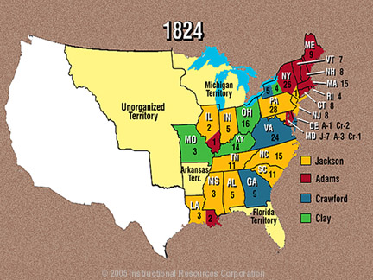

Slide 4
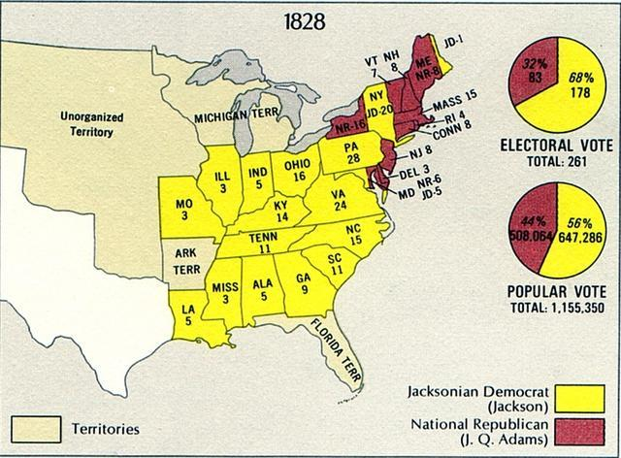
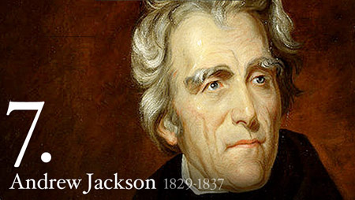
Only 4 years Later!
Start of Jacksonian Democrats!
Jackson becomes the 7th President.
First President to have an assassination attempt.
Strong beliefs and extremely different from any other President before him

