Slide 1
Article II
The Executive Branch

Slide 2
Who is the leader of the Executive Branch?
The President

Slide 3
What are the requirements to be eligible for the presidency?
35 years old
Natural born citizen

Slide 4
How much is the president paid each year?
$400,000 per year
$50,000 expense account

Slide 5
What is the president’s main job?
Enforce or Execute the laws passed by congress

Slide 6
How long is the term of the president?
4 years
How terms can the president serve?
2 terms

Slide 7
List the three main powers of the president?
Commander and chief of the army
Power to make treaties
Power to make appointments

Slide 8
What does the president explain in the “State of the Union Address?
He explains to Congress the condition of the nation and recommends laws to help the country.

Slide 9
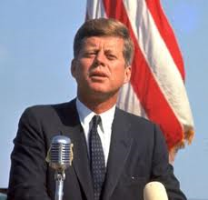
Who was the youngest president ever elected?
John F. Kennedy
43 years old

Slide 10
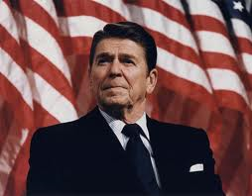
Who was the oldest president ever elected?
Ronald Reagan
69 years old

Slide 11
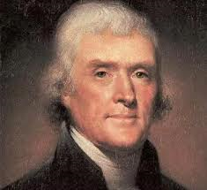
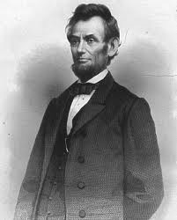
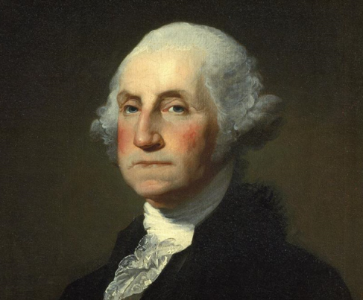
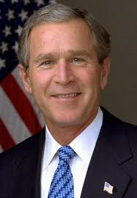
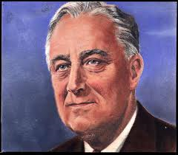
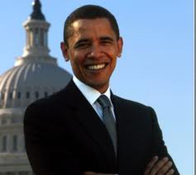
Who was your favorite president?

