Slide 1
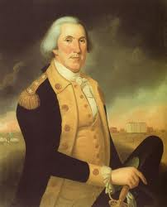
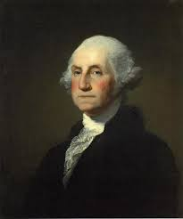
Washington As President
1789-1797
Precedents of the
1st President

Slide 2
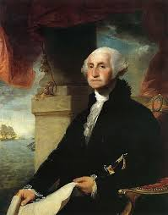
Precedent
What is a precedent?
An earlier event or action that is regarded
as an example or guide to be considered in subsequent similar circumstances.
Washington began his first term with many firsts:
Create and set-up parts of new government
Establish foreign policy
Settled domestic/internal conflicts

Slide 3
French Revolution & Neutrality Proclamation
France rebelled against their King and started revolution in 1789
Americans supported French Revolution, but were concerned by their violence
A few years later France and Britain went to war (again)
Washington decided to remain neutral or not take sides; first foreign policy Of U.S.

Slide 4
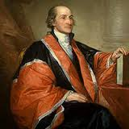
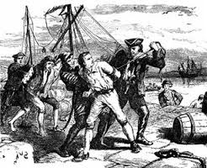
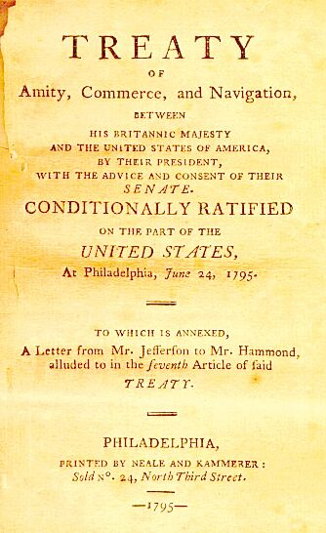
Jay’s Treaty
Britain was (Stealing) U.S. ships & encouraging Native Americans to fight U.S. settlers in northwest
Created a Treaty as a compromise to avoid war again
British had to pay US damages for ships & leave NW forts
First time to agree to something that was unpopular for the good of the country

Slide 5
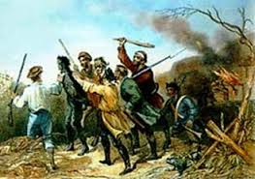
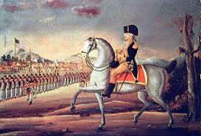
WHISKEY REBELLION
Congress passed tax on whiskey to raise money to pay federal debt Farmers in Pennsylvania upset, aimed at them
Washington personally led army against rebellion and rebels fled, rebellion ended without a battle
First time country had rebellion and government was strong enough to stop it (Shays Rebellion)

Slide 6
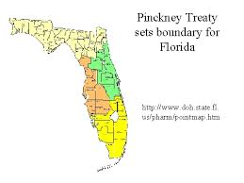
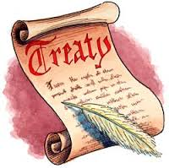
Pinckney’s Treaty
Spanish disputed border between US & Florida so closed port of New Orleans to US trade
Businesses & economy hurt
Treaty set border and gave US right to use New Orleans

Slide 7
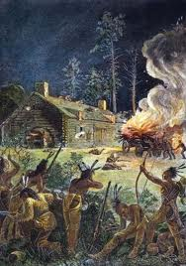
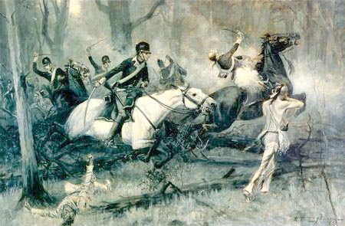
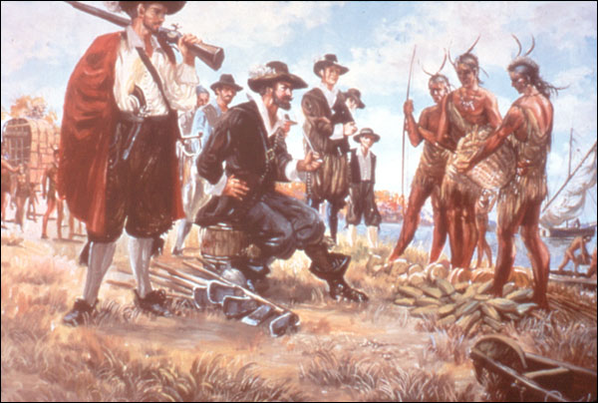
CONFLICT IN NORTHWEST TERRITORY
Native Americans fought US settlers moving into northwest territory lands
Native Americans realized they were outmatched and asked for peace, signed Treaty
First time US used military force against Native Americans and agreed to a treaty

