Slide 1
ECONOMICS
National Finances in Simple Terms

Slide 2
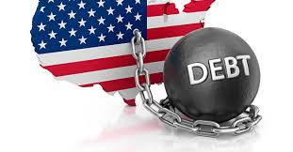
State & National Debt
State Debt
National Debt
All money owed by individual states
All money owed by federal government for the whole country
States & Federal government borrowed money to pay debt
Example: Paid for Revolutionary War by selling bonds

Slide 3
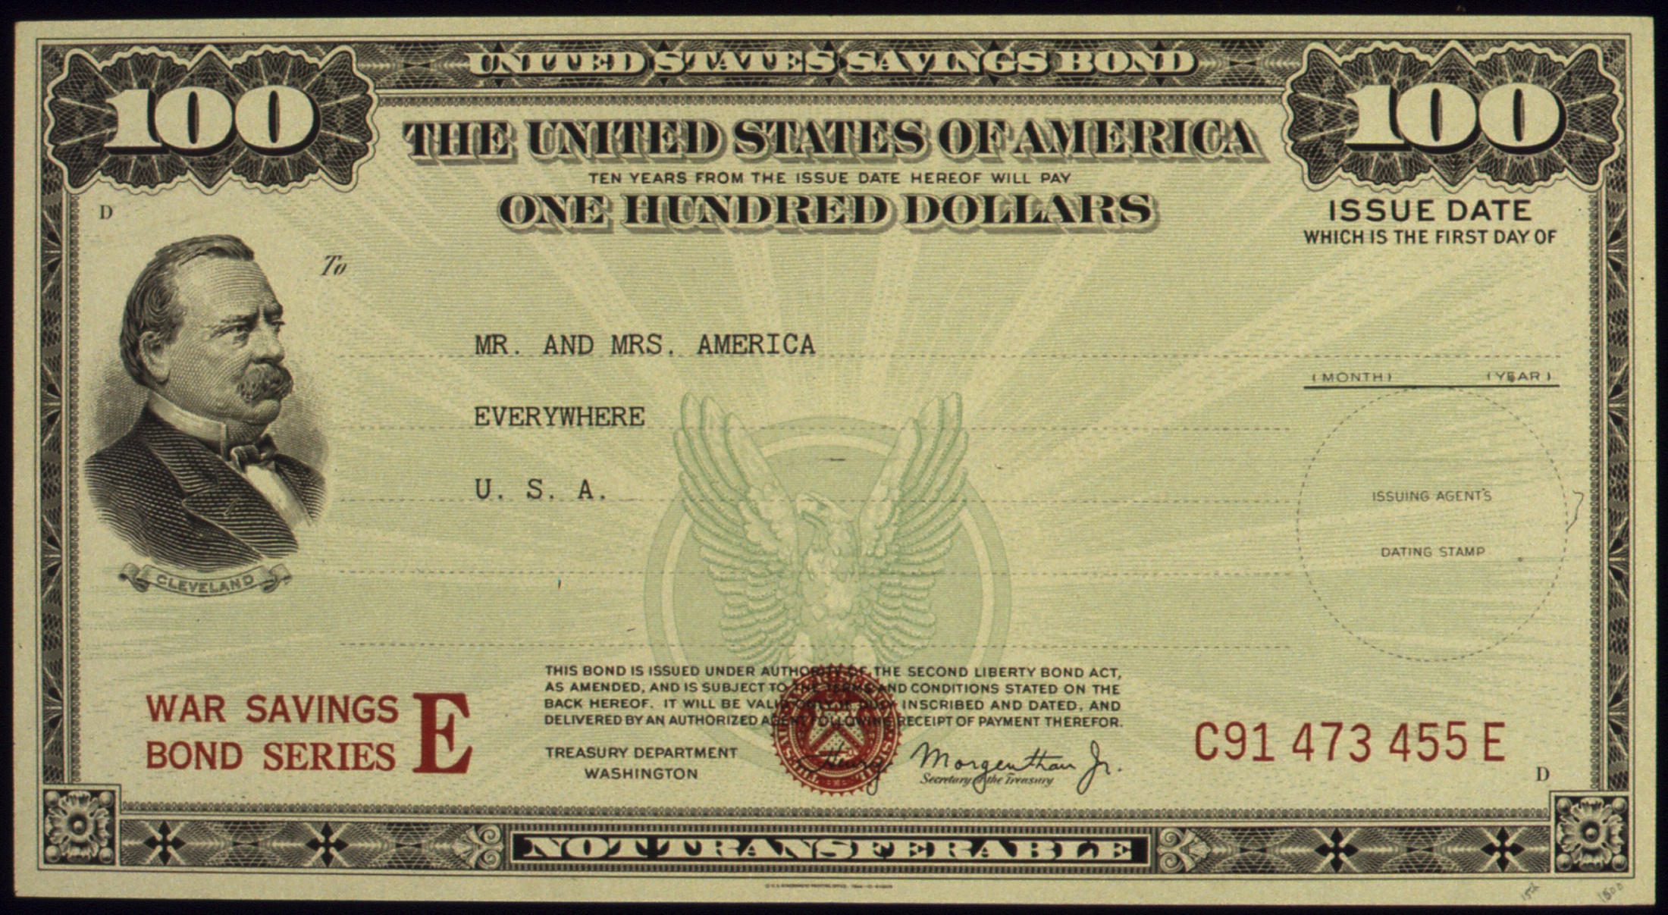
Bonds
Certificate that promises to repay money loaned plus interest by a certain date
Sold for money loaned or to farmers/businesses for good or services

Slide 4
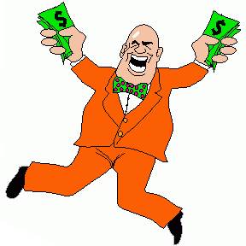
Speculators
People who bought bonds from owners cheap
Hope will get full value of bond later
Usually purchased from desperate people who needed the money NOW and could not wait for bond to mature

Slide 5
Interest
Amount of extra money you get to let a bank or person borrow your money
Based on a percentage and a length of time
Compound Interest Example: $100 with 5% interest over 5 years
Year 1:
$100 x 5% = $5
$100 + $5 = $105
Year 2:
$105 x 5% = $5.25
$105 + $5.25 = $110.25
Year 3:
$110.25 x 5% = $5.51
$110.25 + $5.51 = $115.76
Year 4:
$115.76 x 5% = $5.79
$115.76 + $5.79 = $121.55
Year 5:
$121.55 x 5% = $6.08
$121.55 + $6.08 = $127.63
Simple Interest Example: $100 with 5% interest over 5 years
Year 1:
$100 x 5% = $5
Year 2:
$100 x 5% = $5
Year 3:
$100 x 5% = $5
Year 4:
$100 x 5% = $5
Year 5:
$100 x 5% = $5
Total: $125

Slide 6
Banks: State & National
Bank: institution that holds money & lends money to people or groups
State Banks
National Bank
Loans and money used for individual states
Loans and money used for the whole country
National bank gets money from taxes
Gives loans to farmers/business

Slide 7
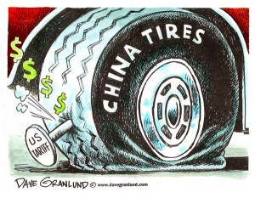
Tariffs & Protective Tariff
Tariff
Protective Tariff
Tax on goods brought into a country to be sold
HIGH tax on goods brought into a country
Tax is designed to help protect American businesses selling same item

Slide 8
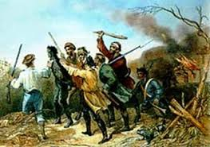
Excise Tax
Tax on production or sale of a specific product
Usually to help raise funds for the state or country
Can help or make people upset
Example: Whiskey tax that started Whiskey Rebellion

