Slide 1
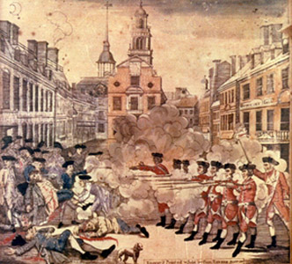
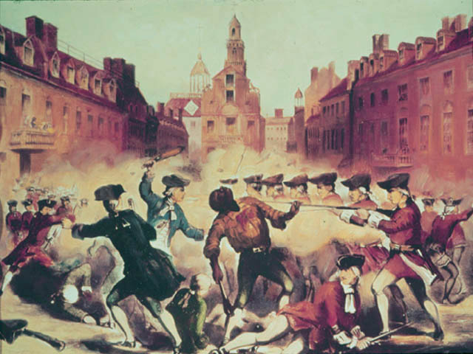
The Boston Massacre
A massacre of the truth

Slide 2
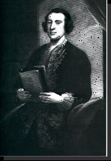
The Genius
Charles Townshend
Minister of Finance
Needed to raise money

Slide 3
Shhh! We’re taxing.
Direct Taxes
Taxes that you know you are paying!!!
Ex. Sales Tax
& the Stamp Act
Indirect Taxes
Secret Taxes
Ex. Tariffs

Slide 4
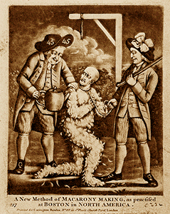
The Townshend Acts
An indirect tax on glass, lead, paper and tea.

Slide 5
Sons of Liberty
Boston Summer of 1765
Called themselves the Loyal Nine
Began to meet in secret to prepare for agitation against the Stamp Act
As the group grew, it became know as the Sons of Liberty

Slide 6
Group Members
Were considered radicals
John Adams- lawyer, Massachusetts
Samuel Adams- political writer, tax collector/fire warden, Boston
Benedict Arnold-businessman, Norwich
Benjamin Edes- journalist/publisher Boston Gazette, Boston
John Hancock- merchant/smuggler/fire warden, Boston
Patrick Henry- lawyer, Virginia
Paul Revere- silversmith, Boston

Slide 7
Colonial Response
Boycott – stop buying
No tax can be collected if no products are purchased.

Slide 8
Protests Increase
March 5th, 1770
Redcoats guarding Customs House
Surrounded by a group of angry colonists
Redcoats fire, killing 5 American Colonists

Slide 9
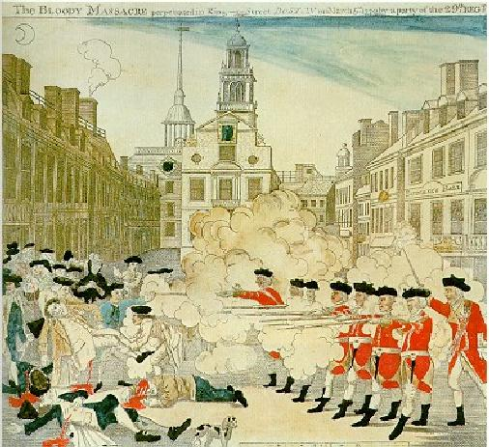

Slide 10
Repealed

