Slide 1
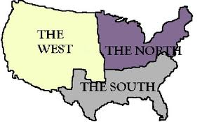
L.O. – Today we will describe the life in the United States prior to the Civil War.
A Nation Divided

Slide 2
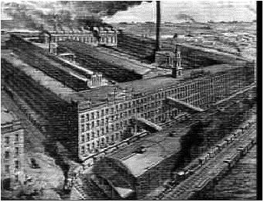
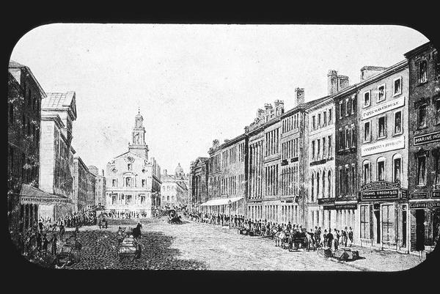
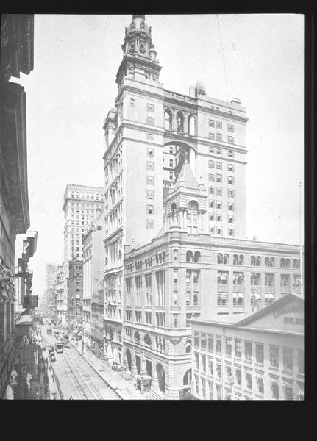
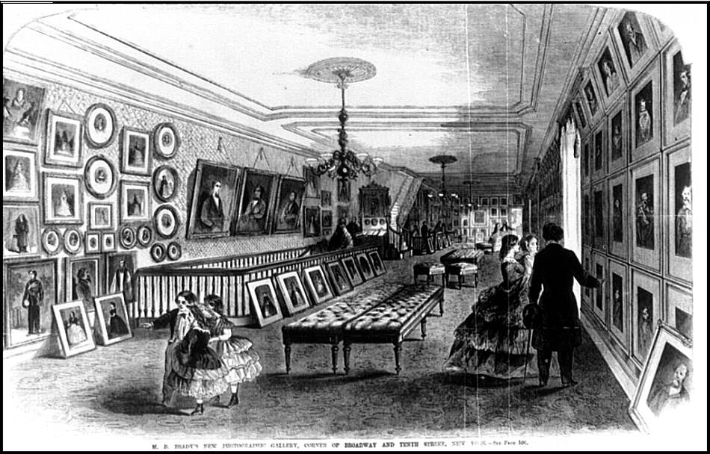
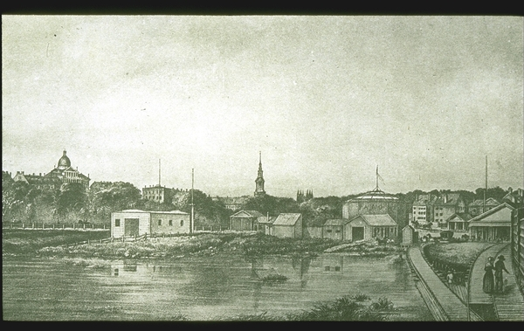
Northeast

Slide 3
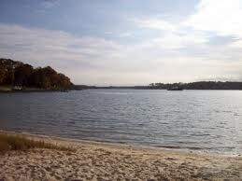
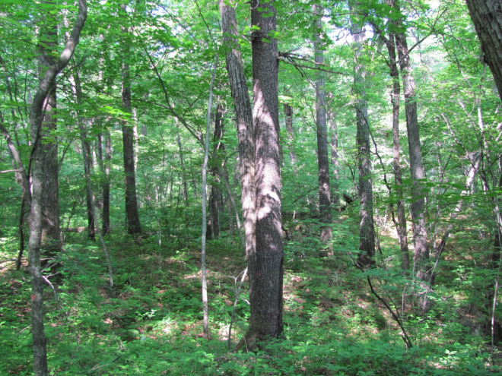
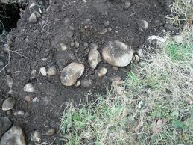
Geography
The North had lots of forests and mountains. They were used for lumber.
Good for mining. There were also lots of bays and inlets on coast.
Cold winters, hot summers, but short growing season.
Notes:
Rocky soil – hard for farming

Slide 4
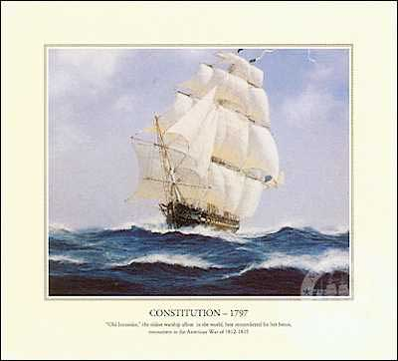
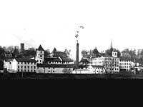

Economy
Spacious harbors, where the seaports were important to economy. This allowed shipbuilding to be a major industry.
Mostly factories producing, manufactured goods made it the wealthiest section overall.
Largest cities most educated region and richest section with the most varied job.

Slide 5
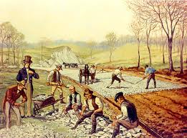
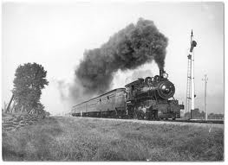
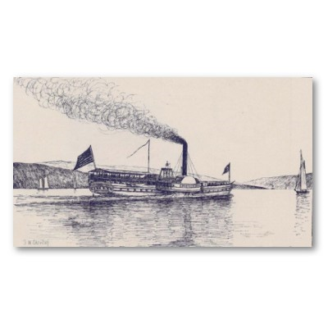
Transportation
Improved and built roads, Steam train made travel over land faster and cheaper.
Faster ships were built to cross the ocean and River travel forced states to build more canals.

Slide 6
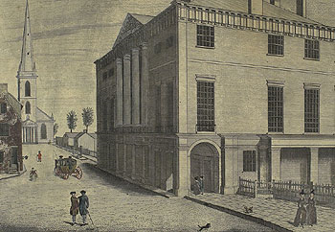
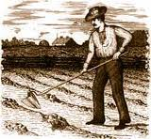


Society
New factories create jobs BUT also put crafts people out of work, Textile mills made cloth used farm girls as workers.
Inventions helped new job grow in north, people used machines to help with shipping (steam engine) and farming (mechanical reaper)

Slide 7

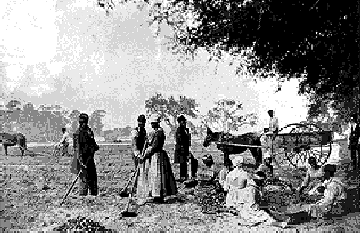
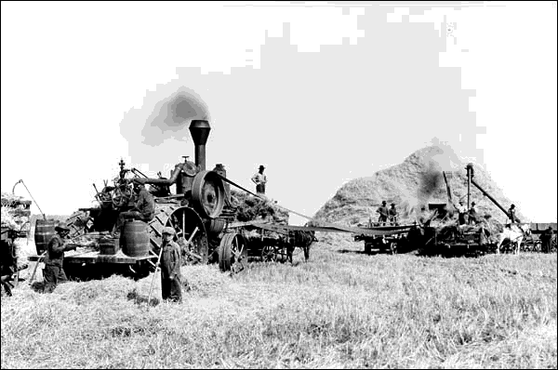
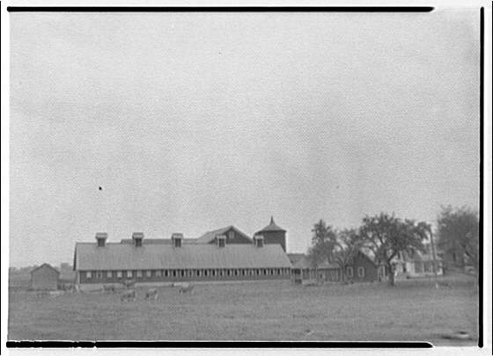
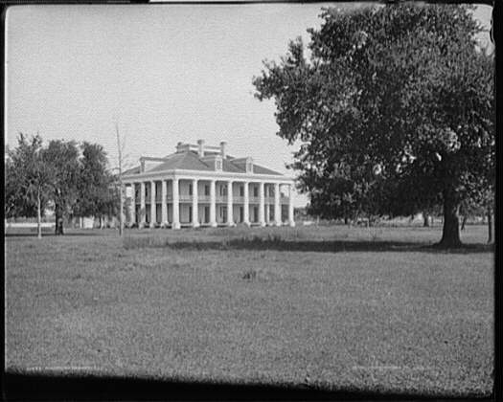

The South

Slide 8

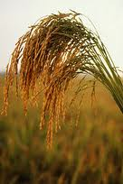
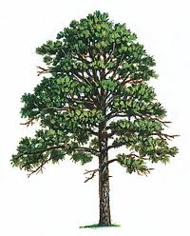
Geography
Mild winters, hot/humid summers, long growing season. Soil ideal for growing rice/sugar/indigo
Fishing and other water activities were popular. Few mountains and forests used for lumber
Broad, flat rivers used as “highways”

Slide 9
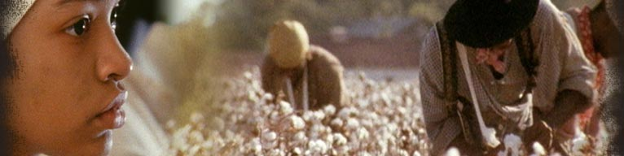
Economy
Slavery was legal, and farmers used slave labor to grow Cotton & tobacco as their main crop.
Large planters were the most influential
The had few schools, people were largely uneducated.

Slide 10
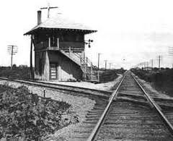
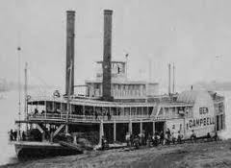
Transportation
Travel was cheap and easy on rivers, because of steamboats. They helped ship cotton to port cities like New Orleans.
Southern cities and towns were close to rivers, many Southerners didn’t want to pay for improvements like roads/canals.

Slide 11
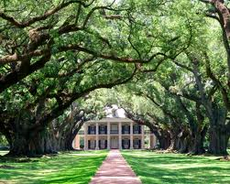
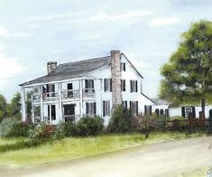
Society
Cotton became the South’s most important crop
Growing cotton wore out the soil and made people look for more land, it also increased need for slaves. (crops like tobacco, rice, sugar, and indigo)
Eli Whitney’s cotton gin change the South’s economy

Slide 12
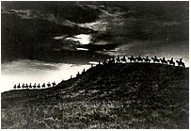
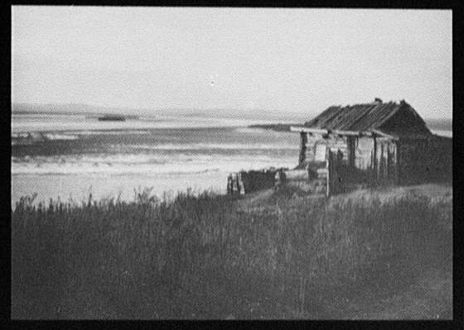
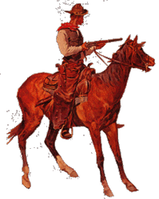
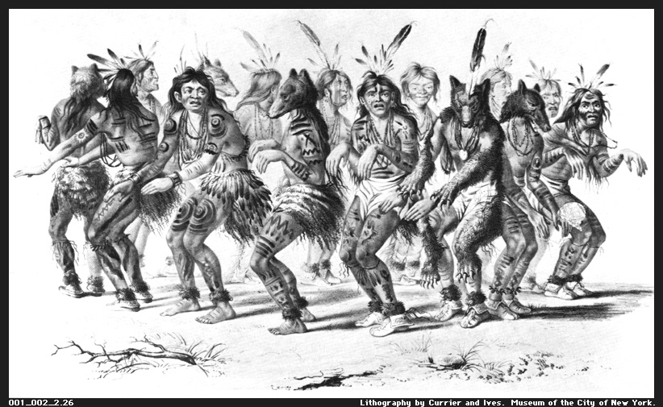

The West

Slide 13
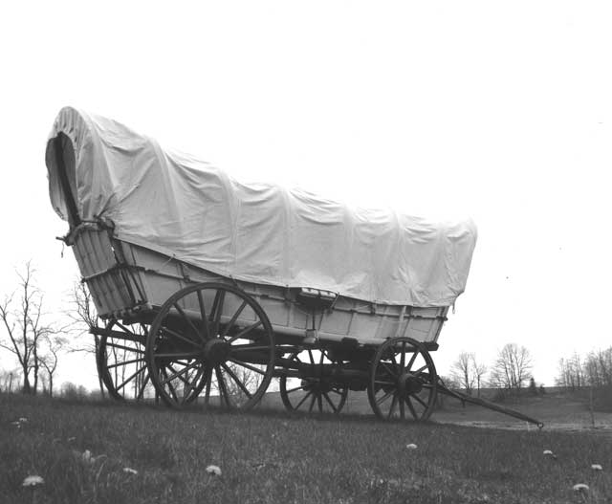
WEST
Wagons allowed settlers to move west

Slide 14
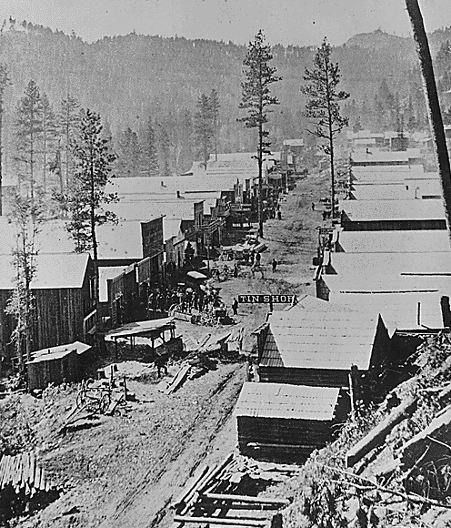
WEST
Fewest large cities – rural and undeveloped.

Slide 15
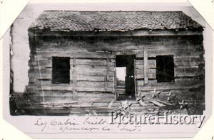
WEST
Log cabins were the most common type of housing.

Slide 16
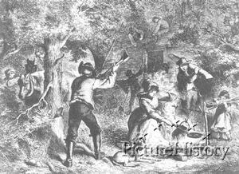
WEST
Most self-sufficient people in the region.

Slide 17
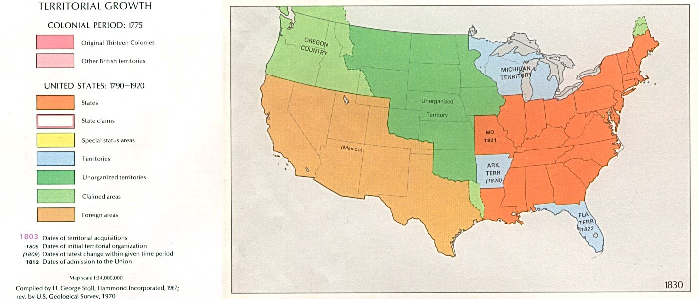
WEST
Land was cheap / affordable

Slide 18
WEST
Equal distribution of wealth

Slide 19
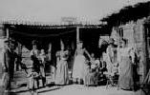
WEST
Women were most respected as equals in this region.

