Slide 1
Manifest Destiny Map

Slide 2
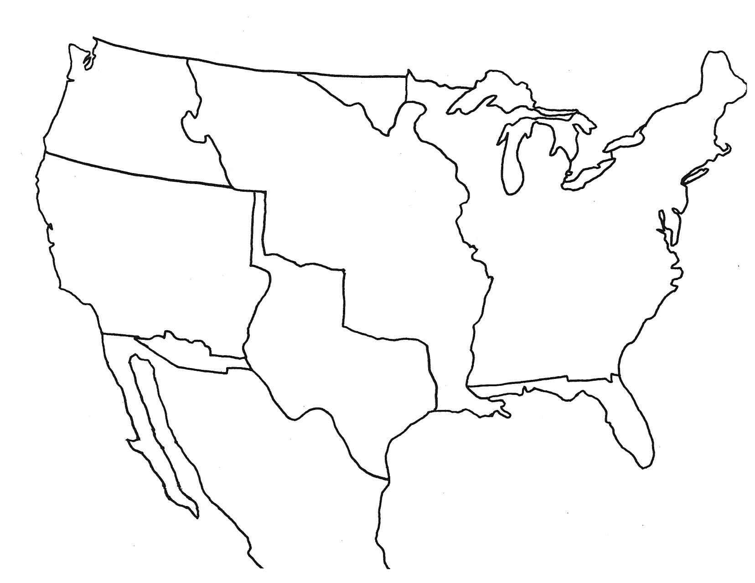

Slide 3
The United States in 1783
Includes land of the original colonies
Colonies declare war against Britain in 1776
Colonies and Britain fight American Revolution
Treaty of Paris in 1783 ends war and gives new United States of America land up to Mississippi River

Slide 5
Louisiana Purchase
President Jefferson sends Monroe and Livingston to France to buy New Orleans
Napoleon needs money to fight wars in Europe so offers all of Louisiana
U.S. buys all of the land for $15 million in 1803

Slide 7
Convention of 1818
Ceded by Britain
Notes:
The Convention respecting fisheries, boundary and the restoration of slaves between the United States of America and the United Kingdom of Great Britain and Ireland, also known as the London Convention, Anglo-American Convention of 1818, Convention of 1818, or simply the Treaty of 1818, was a treaty signed in 1818 between the United States and the United Kingdom. It resolved standing boundary issues between the two nations, and allowed for joint occupation and settlement of the Oregon Country, known to the British and in Canadian history as the Columbia District of the Hudson's Bay Company, and including the southern portion of its sister for district New Caledonia.
The treaty marked the last permanent major territorial loss of Continental United States, the northern most tip of the territory of Louisiana above the 49th parallel north, known as the Milk River in present day southern Alberta. Britain ceded all of Rupert's Land south of the 49th parallel and west to the Rocky Mountains, including the Red River Colony.
The treaty name is variously cited as Convention respecting fisheries, boundary, and the restoration of slaves^{[1]}, Convention of Commerce (Fisheries, Boundary and the Restoration of Slaves)^{[2]}, and Convention of Commerce between His Majesty and the United States of America^{[3][4]}.
Article I secured fishing rights along Newfoundland and Labrador for the U.S.
Article II set the boundary between British North America and the United States along "a line drawn from the most northwestern point of the Lake of the Woods, [due south, then] along the 49th parallel of north latitude..." to the "Stony Mountains"^{[3]} (now known as the Rocky Mountains). Britain ceded all of Rupert's Land south of the 49th parallel, including the Red River Colony. This settled a boundary dispute caused by ignorance of actual geography in the boundary agreed to in the 1783 Treaty of Paris that ended the American Revolutionary War. That earlier treaty had placed the boundary between the United States and British possessions to the north along a line going westward from the Lake of the Woods to the Mississippi River. The parties failed to realize that the river did not extend that far north, so such a line would never meet the river. The new treaty also created the anomalous Northwest Angle, the small section of the present state of Minnesota that is the only part of the United States outside Alaska north of the 49th parallel.
Article III provided for joint control of land in the Oregon Country for ten years. Both could claim land and both were guaranteed free navigation throughout.
Article IV confirmed the Anglo-American Convention of 1815, which regulated commerce between the two parties, for an additional ten years.
Article V agreed to refer differences over a U.S. claim arising from the Treaty of Ghent, which ended the War of 1812, to "some Friendly Sovereign or State to be named for that purpose". The U.S. claim was for return of, or compensation for, slaves that were in British territory or on British naval vessels when the treaty was signed. The Treaty of Ghent article in question was about handing over property, and the U.S. claimed that these slaves were the property of U.S. citizens.^{[3]}
Article VI established that ratification would occur within at most six months of signing the treaty.

Slide 9
Florida
President Monroe sends Andrew Jackson to stop raids into Georgia
Jackson marches into Florida and takes control
Adams-Onis Treaty of 1819 give U.S. Florida from Spain
Notes:
The treaty was signed at Washington, February 22, 1819, by John Quincy Adams, secretary of state, and Luis de Onís, Spanish minister. Ratification was postponed for two years, because Spain wanted to use the treaty as an incentive to keep the United States from giving diplomatic support to the revolutionaries in South America. As soon as the treaty was signed, the U.S. Senate ratified unanimously; because of Spain's stalling, a new ratification was necessary and this time there were objections. Henry Clay and other Western spokesman demanded that the Spain also give up Texas. This proposal was defeated by the Senate, which ratified the treaty a second time on February 19, 1821. Ratifications were exchanged three days later and the treaty was proclaimed on February 22, 1821, two years after the signing.^{[8]}
The Treaty closed the first era of United States expansion by providing for the cession of East Florida, the abandonment of the controversy over West Florida (which had been seized by the United States), and creation of a boundary with the Spanish province of Mexico that clearly made Texas a part of Mexico, thus ending the vagueness of the boundary of the Louisiana Purchase. Spain also ceded to the United States its claims to the Oregon Country.
The U.S. did not pay Spain for Florida but did agree to pay the legal claims of American citizens against Spain, to a maximum of $5 million.^{[9]} Pinckney's Treaty of 1795 between the U.S. and Spain was to remain in force. Spanish goods received certain tariff privileges in Florida ports.
The U.S. received ownership of Spanish Florida (British East and West Florida 1763-1783). The U.S. relinquished its own claims on parts of Texas west of the Sabine River and other Spanish areas.
The Adams–Onís Treaty settled the dispute by attempting to draw clearer borders, roughly granting Florida and Louisiana to the U.S. while giving to Spain everything west of Louisiana from Texas to California. The new boundary was to be the Sabine River north from the Gulf of Mexico to the 32nd parallel north, then due north to the Red River, west along the Red River to the 100th meridian west, due north to the Arkansas River, west to its headwaters, north to the 42nd parallel north, and finally west along that parallel to the Pacific Ocean. Informally this has been called the "Step Boundary", although the step-like shape of the boundary was not apparent for several decades—the source of the Arkansas, believed to be near the 42nd parallel, was not known until John C. Frémont located it in the 1840s, hundreds of miles south of the 42nd parallel.

Slide 11
Texas Annexation
American settlers made an agreement with Spain then Mexico to live in Texas
Other settlers rush to live in Texas and do not follow the agreement
Mexico and Texans fight and Texas eventually wins independence
Texas is an independent country for ~10 years (1836-1845)
United States votes to annex Texas in 1845

Slide 13
War with Mexico
US and Mexico cannot agree on a border to Texas (US-Rio Grande, Mexico-Nueces River)
Mexican soldiers fire on US soldiers
President Polk encourages Congress to declare war
General Taylor leads U.S. troops into Mexico and fights Santa Anna
General Scott leads troops into Mexico City
War ends with Treaty of Guadalupe Hidalgo
US gets Texas and Mexican Cession
Mexico gets $15 million

Slide 15
Oregon Country
Jointly occupied by the U.S. and Britain for years
Compromise treaty is reached in 1846 that splits land at the 49th parallel

Slide 17
Mexican Cession
President Polk sends representatives to Mexico to buy land but they are refused by Mexican representatives
When war with Mexico breaks out General Kearny leads an army into New Mexico and takes control without fire a shot
Explorer John C. Frémont leads a rebellion against Mexican rule in California, then joins with Kearny to make California under U.S. control

Slide 19
Gadsden Purchase
U.S. buys land from Mexico for $10 million to help build a railroad
Notes:
The Gadsden Purchase (known as Venta de La Mesilla, or "Sale of La Mesilla", in Mexico^{[2]}) is a 29,670-square-mile (76,800 km²) region of present-day southern Arizona and southwestern New Mexico that was purchased by the United States in a treaty signed by James Gadsden, the American ambassador to Mexico at the time, on December 30, 1853. It was then ratified, with changes, by the U.S. Senate on April 25, 1854 and signed by President Franklin Pierce, with final approval action taken by Mexico on June 8, 1854. The purchase was the last major territorial acquisition in the contiguous United States, adding an area the size of Scotland to the United States.
The purchase included lands south of the Gila River and west of the Rio Grande. The Gadsden Purchase was for the purpose of the US's construction of a transcontinental railroad along a deep southern route. It was also related to reconciliation of outstanding border issues following the Treaty of Guadalupe Hidalgo, which ended the Mexican–American War of 1846–48.
As the railroad age progressed, business-oriented Southerners saw that a railroad linking the South with the Pacific Coast would expand trade opportunities. They thought the topography of the southern portion of the Mexican Cession was too mountainous to allow a direct route. Projected southern routes tended to run to the north at their eastern ends, which would favor connections with northern railroads and ultimately favor northern seaports. Southerners saw that to avoid the mountains, a route with a southeastern terminus might need to swing south into what was then Mexican territory.
The administration of President Franklin Pierce, strongly influenced by Secretary of War Jefferson Davis, saw an opportunity to acquire land for the railroad, as well as to acquire significant other territory from northern Mexico.^{[3]} In the end, territory for the railroad was purchased for $10 million ($243,629,630 today), but Mexico balked at any large-scale sale of territory. In the United States, the debate over the treaty became involved in the sectional dispute over slavery, ending progress before the American Civil War in the planning or construction of a transcontinental railroad.

