Slide 1
John Adams’
Presidency
1797-1801

Slide 2
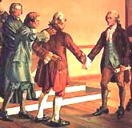
Election of 1796 Issues in the Young Nation
Federalists and Democratic-Republicans aren't speaking to each other.
End of the One-Party System
http://www.james.com/beaumont/images/smith_melancton1.jpg

Slide 3
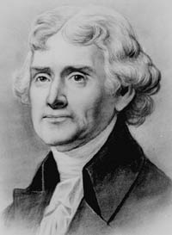
Election of 1796 The Potential Candidates
Jefferson was the Democratic-Republican candidate.
Thomas Jefferson
http://www.writespirit.net/authors/thomas_jefferson/Thomas-Jefferson-Pic.jpg

Slide 4
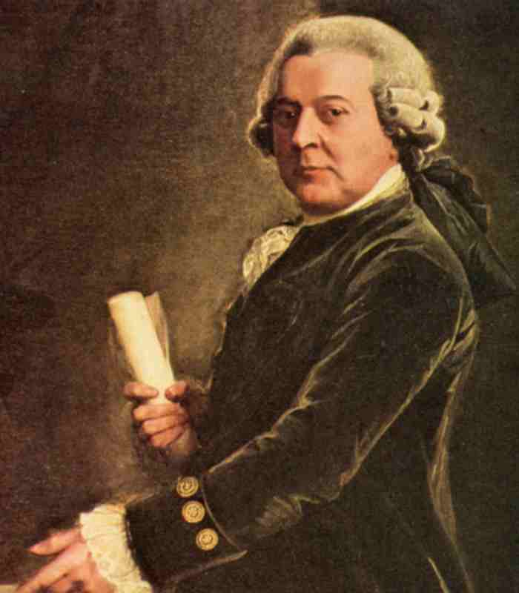
Election of 1796 The Potential Candidates
Other candidate was the Vice-President, John Adams, who was also a Federalist, but more strong-minded.
John Adams
http://www.tamut.edu/academics/mperri/AmSoInHis/John-Adams.jpg

Slide 5
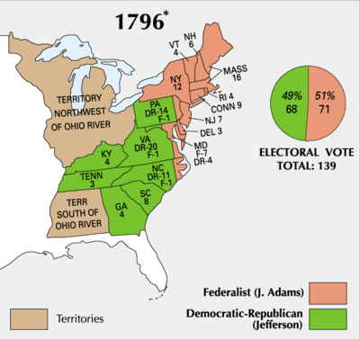
Election of 1796 Results in the Electoral College
Adams 71, Jefferson 68.
Adams takes Jefferson as Vice-President.
Does not trust Hamilton.

Slide 6
XYZ Affair
Also Called The "Quasi-War”
Revolutionary France attacks American shipping to influence the election and hurt Britain.
France is mad about special privileges that Britain gained from Jay's Treaty to end.

Slide 7
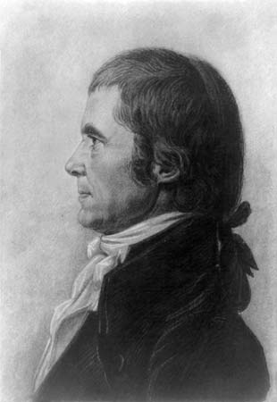
XYZ Affair
Adams sends three commissioners to negotiate a peace.
John Marshall
http://cache.eb.com/eb/image?id=97171&rendTypeId=4

Slide 8
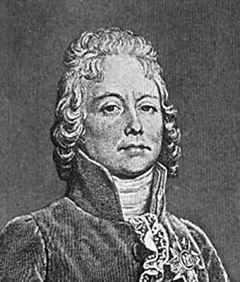
XYZ Affair
French foreign minister.
Sends three agents (known as X, Y, and Z)
demand a huge bribe from the Americans before he would talk with them.

Slide 9
XYZ Affair
The American commissioners refuse and peace talks stop.
Both sides attack each others ship.
Federalists want Congress to declare war to restore American honor.
"Millions for defense, but not one cent for tribute!”

Slide 10
XYZ Affair
Congress ends the French alliance.
America Creates a naval department.
Congress appropriates money to triple the size of the army and build 40 warships.
Washington comes out of retirement to lead the American forces.

Slide 11
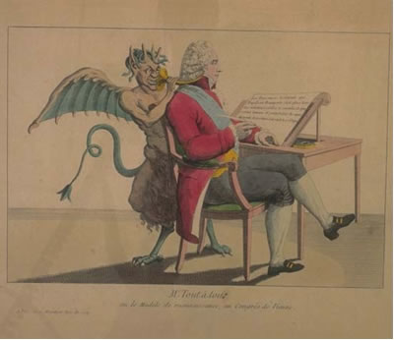
France Capitulates
France does not want war with America.
Does not want to add another enemy.
Will accept new negotiators.

Slide 12
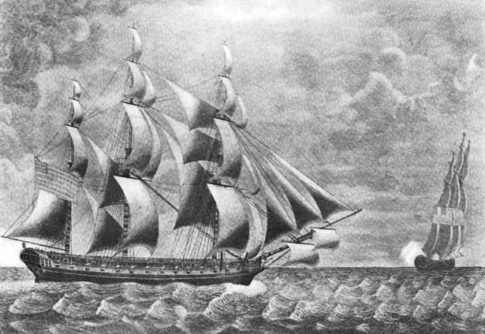
The Alien & Sedition Acts
Aimed at keeping refugees out of America.
French refuges want to escape the Revolution.
Americans don’t want them to be spies.

Slide 13
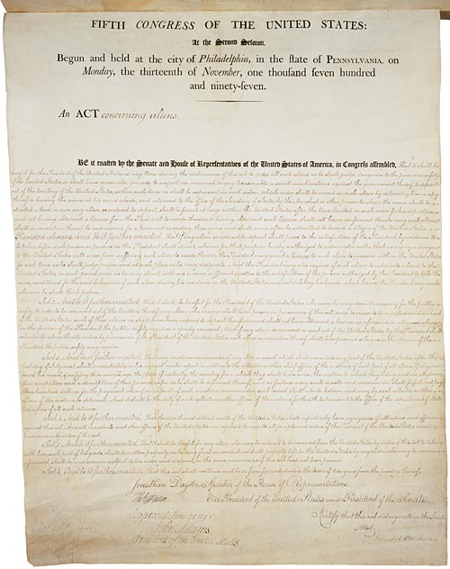
The Alien & Sedition Acts
Naturalization Act.
Increased the eligibility for citizenship from 5 to 14 years.
Alien Enemies Act.
President has the power to arrest or expel enemies in times of "declared war."
Alien Act.
President can expel all aliens deemed "dangerous to the peace and safety of the United States."
The Alien Act
http://www.historicaldocuments.com/AlienandSeditionActs1.jpg

Slide 14
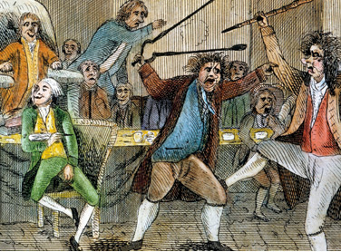
The Alien & Sedition Acts The Sedition Act
Made it a crime to "impede the operation of any law."
Illegal to publish or speak any "false, scandalous, and malicious" criticism of high government officials.
A Fight in Congress
Over the Sedition Act
http://www.apfn.net/MESSAGEBOARD/07-02-04/tjalien.jpg

