Slide 1
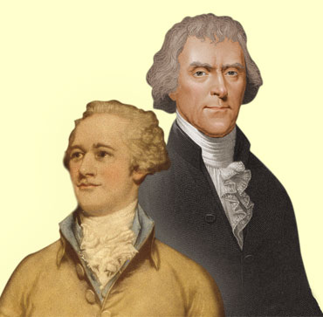
Jefferson vs. Hamilton
And the development of political Parties

Slide 2
Viewpoints
Philosophy
Best form of Government
Government Leadership
View of the National Government
View of the Constitution
National Bank
Foreign Affairs

Slide 3
Philosophy
Jefferson
Man is basically good, capable of governing himself.
Hamilton
Man is basically evil, must be closely controlled.

Slide 4
Best Government
Jefferson
Democracy
Government by the people is more responsive to people’s needs
Hamilton
Monarchy
Strong Central Government will better control man

Slide 5
Government Leadership
Jefferson
The Common Man,
as long as they have a good education
Hamilton
Wealthy, Upper class, Distrusts the Common Man

Slide 6
View of the National Government
Jefferson
Weak Central Government, reserve power to the states.
Hamilton
Stronger Central Government will be better at controlling man’s evil nature.

Slide 7
View of the Constitution
Jefferson
Strictly interpreted, Government only has the power granted by the constitution.
Hamilton
Loosely interpreted,government needs more power than granted to function properly.

Slide 8
National Bank
Jefferson
Distrusts the wealthy merchant class, believes it is not the government’s duty to run a National Bank.
Hamilton
Believes it is necessary and proper for the government to run a bank.

Slide 9
Foreign Affairs
Jefferson
Favors relations with France, supports France in European Wars
Hamilton
Favors relations with Great Britain, supports Britain in European Wars

Slide 10
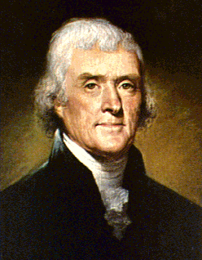
Thomas Jefferson
People are good
Capable of Governing themselves
The Common Man should lead
Weak Government power to the people
Strict Constitution
Democratic - Republican Party

Slide 11
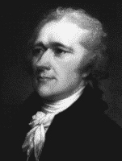
Alexander Hamilton
People are evil
Man must be closely controlled.
Monarchy - Strong Government
Loose Constitution - more power.
Federalist Party

