Slide 1
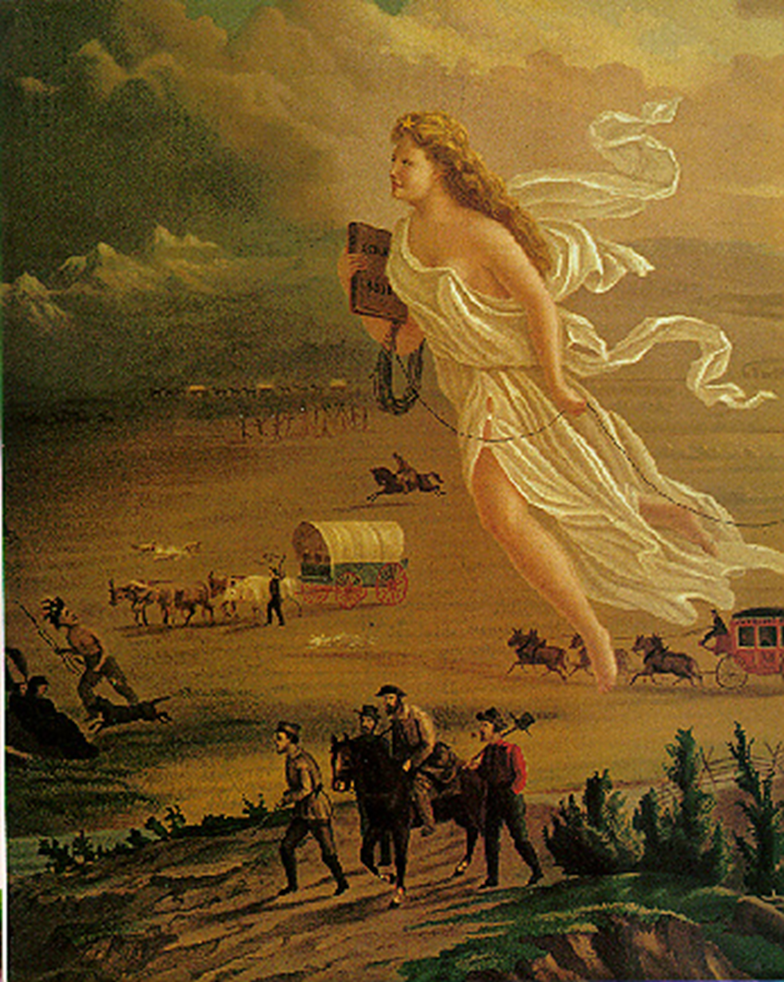
Manifest Destiny
Eight Trails West

Slide 2
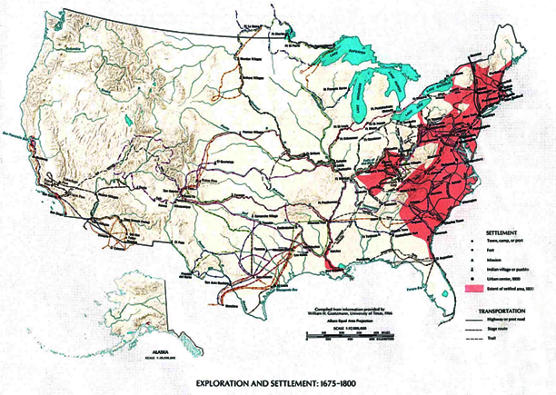
1675 to 1800

Slide 3
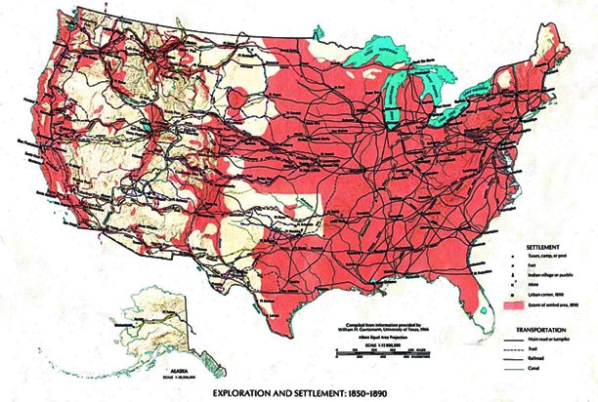
1850 to 1890

Slide 4
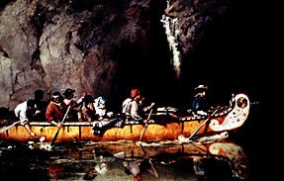
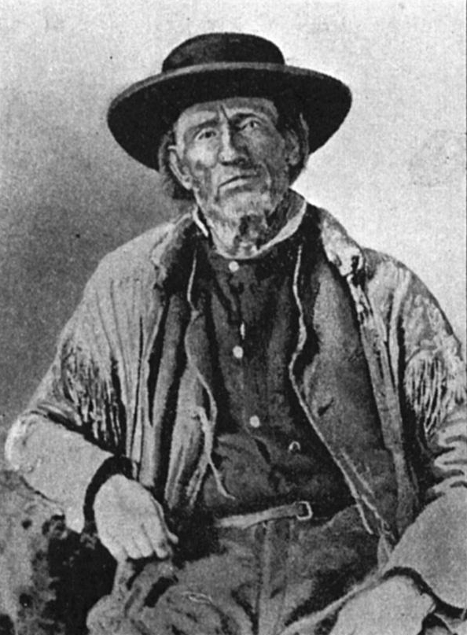
Mountain Men and the Fur Trade
Rugged Individualist Spirit
Valuable hides - beaver & buffalo
established trade & transportation

Slide 5
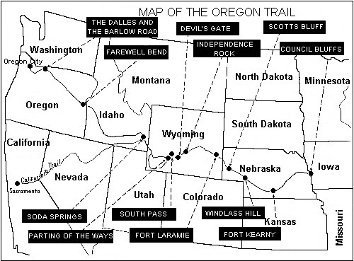
The Santa Fe Trail
1,000 miles from Missouri to Santa Fe
Trade Route opened in 1821
Main route into Spanish territory

Slide 6
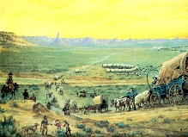
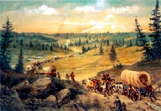
The Oregon-California Trail
“The Lure of Oregon”
“The Gold of California”

Slide 7
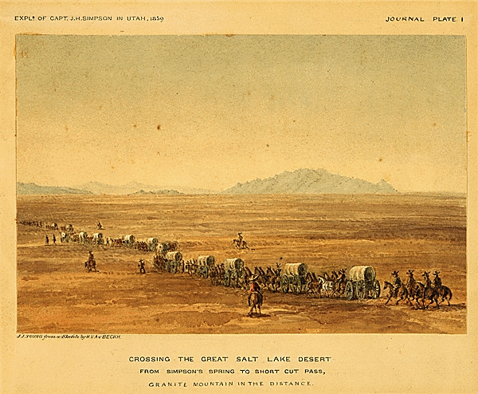
The Mormon Trail
1847
Escaping religious persecution
Mormons follow Bringham Young to settle the Salt lake City Area

Slide 8
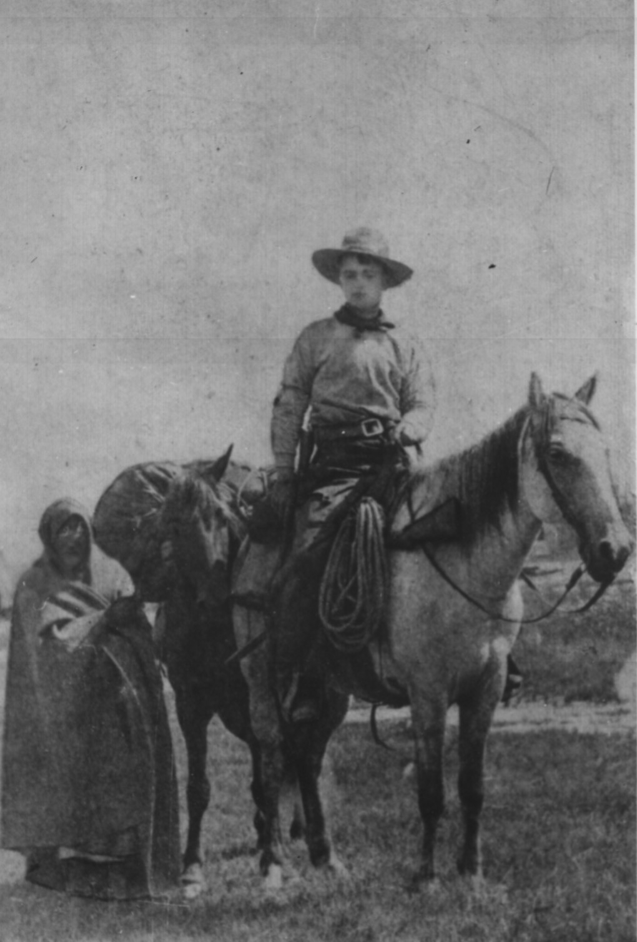
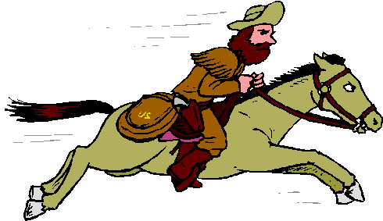
The Pony Express
Unofficial, private mail service
Missouri to California
Short lived:
  Opened April 3rd, 1860
  Closed November 20th 1861

Slide 9
Transcontinental Telegraph
“Wired” Continent
East hears West
October 24th, 1861

Slide 10
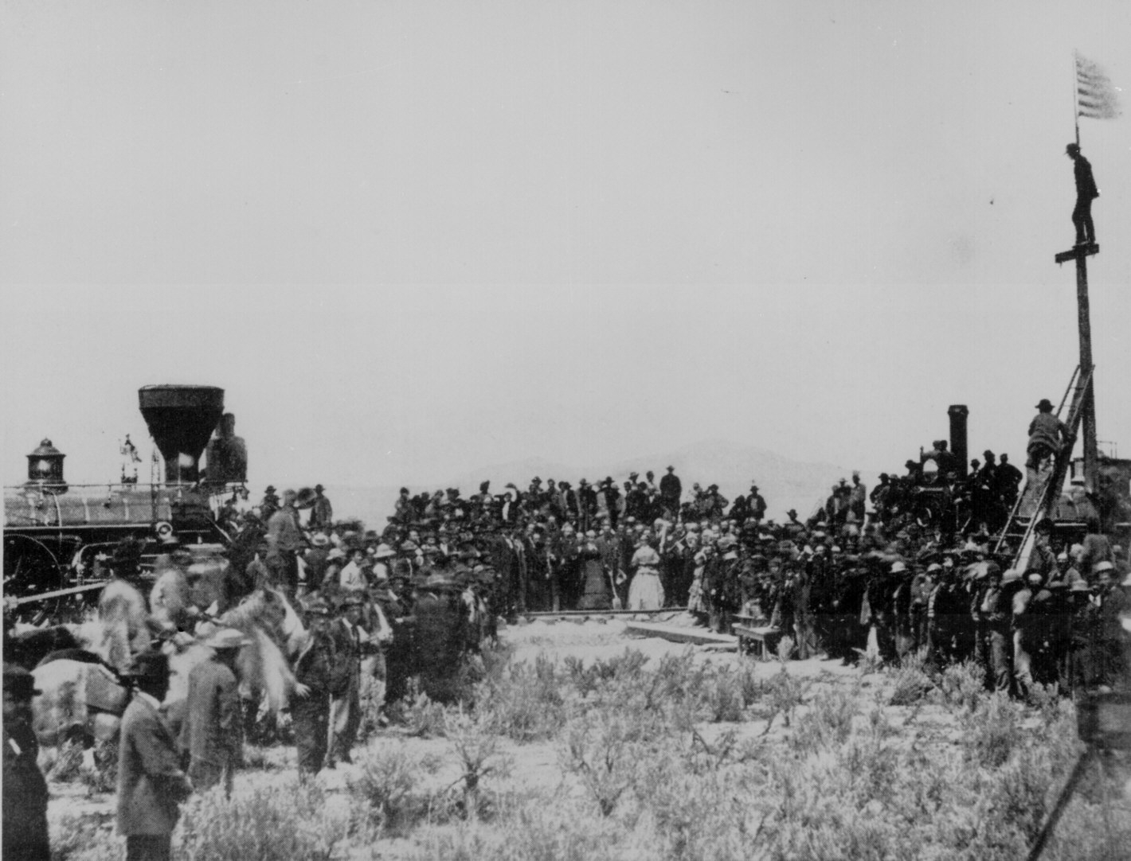
Transcontinental railroad
New York to Sacramento
East meets West
May 10th, 1869
Promontory Point Utah

Slide 11
1675 to 1800

Slide 12
1850 to 1890

Slide 13


