Slide 1
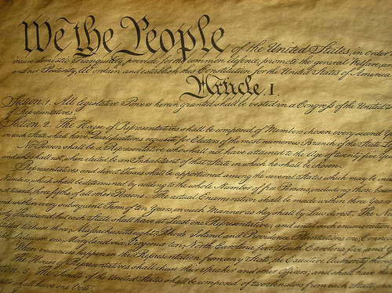
The Constitution
Preview Review Overview

Slide 2
Objective for the Day
Content (Know) – Students will be introduced to the United States Constitution and the different parts of US government.
Language (Show) – Listen carefully, take a few brief notes, Share interact with classmates and summaries the information presented to them.

Slide 3
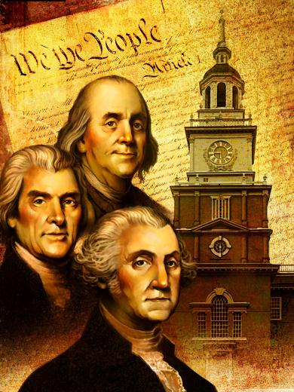
Background
Ratified - October 17, 1787
Reason Created – Articles of Confederation did not work
Where was it made - Philadelphia
Who wrote it – 55 men
Nickname - The Miracle in Philadelphia

Slide 4
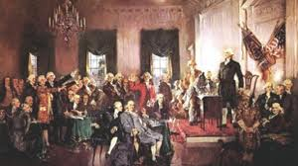
Miracle in Philadelphia
Strong Enough to Protect us
Not too strong to limit our freedom
Lasted from 1787 to today!

Slide 5
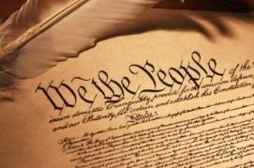
Parts of the Constitution
Preamble
Articles
Amendments

Slide 6
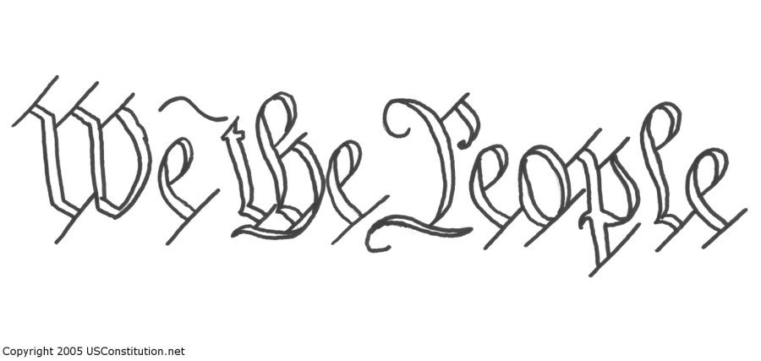
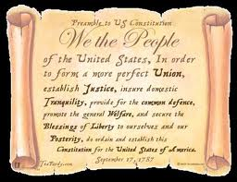
The Preamble
Goals of the Government

Slide 7
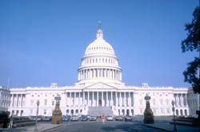
Article I
Legislative Branch
aka the Congress
Makes the laws

Slide 8
Article II
Executive Branch
aka the President
Enforces the laws

Slide 9
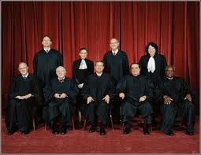
Article III
Judicial Branch
aka the Supreme Court
Interprets the laws

Slide 10
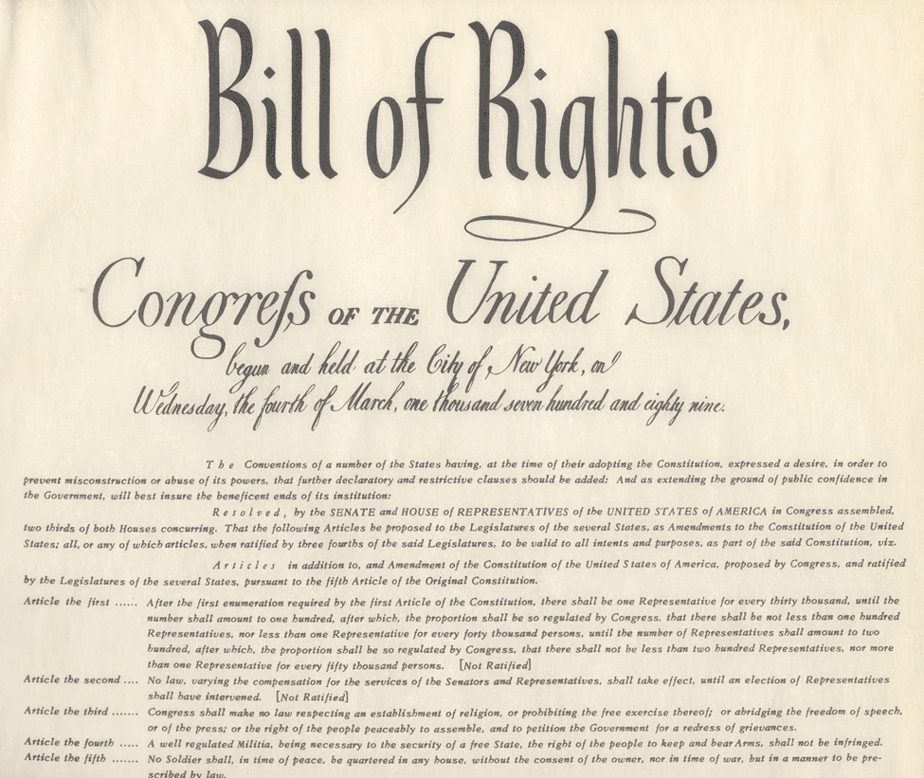
The Bill of Rights
The first 10 Amendments to the Constitution
Protect s your basic rights

