Slide 1
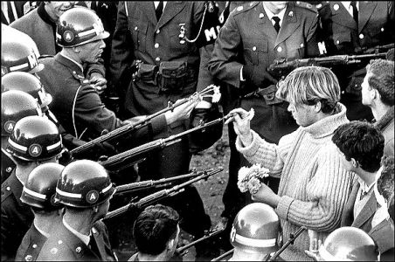
Journal
Explain a time when you took a risk and challenged an authority figure because you thought they were wrong and you were right.

Slide 2
Learning Objectives
Content (Know): Identify Key/Major events that lead to the American Revolution, and some of the turmoil that caused the War to begin.
Language (Show): Listen carefully, take notes, consider both sides and personally identify with your own situation.

Slide 3
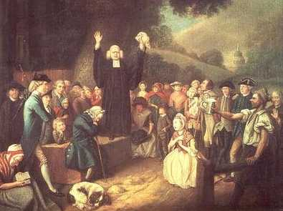
The Great Awakening
1730’s and 1740’s a religious revival started in the colonies
George Whitfield
Jonathan Edwards

Slide 4
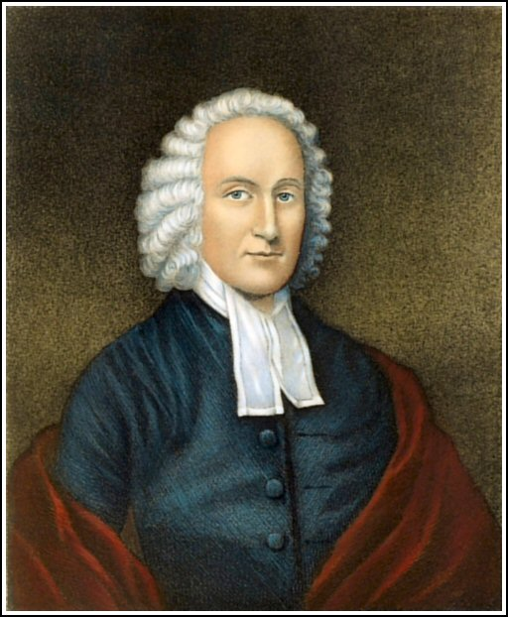
Jonathan Edwards
New England preacher
Told people to examine their lives
If you don’t follow the Bible you will be like
“sinners in the hands of an angry God”

Slide 5
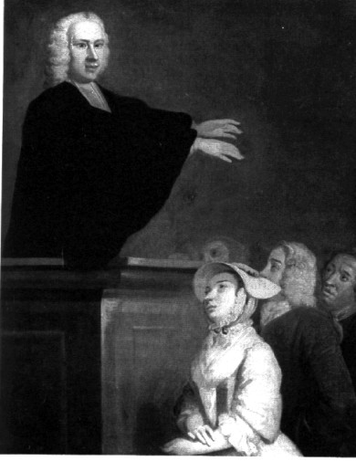
George Whitfield
English minister
Gave fiery speeches
From Massachusetts to Georgia

Slide 6
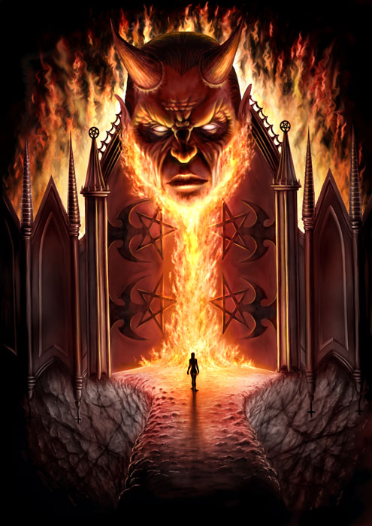
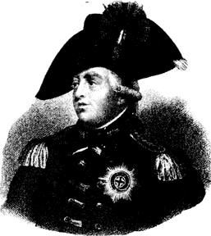
Impact/Effects of the Great Awakening
People began to challenge the church
If they are willing to challenge the church and risk damnation then
they would have no problem challenging the government

Slide 7
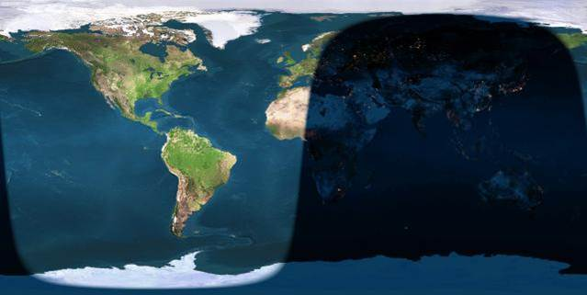
Problems Governing the Colonies
“3000 miles of water are the true father of American Independence.”

Slide 8
Two Main Problems England had Governing the Colonies
Communication
Trade

Slide 9
Communication
England could not govern over 3000 miles of Ocean.
Letters would take too long Colonist could not wait for response
Party time…

Slide 10
Trade
American colonists were trading with other countries.
England was not benefiting from their colonies.

Slide 11
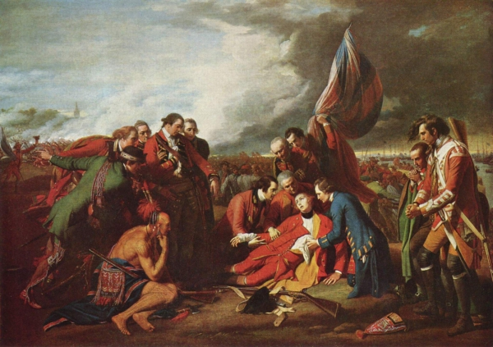
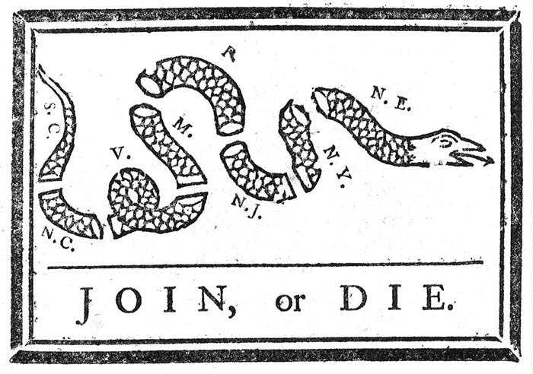
The French & Indian War
Battle for land
French do well with the help from the Indians
Washington almost killed, then captured

Slide 12
Postwar Problems
The cost of the war
The cost of having British Soldiers in the colonies to protect and patrol the new territory
Who will pay the bill?
King George?
The Colonists?

Slide 13
American Revolution
Problems Governing the Colonies
Look at what you wrote in your quick write…
Use that to identify with the colonist,
Explain to me why England is having problems with the colonies and what do you expect is going to happen next.

